Slide 1
2014 TEP IRP Reference Case
Mike Sheehan
Director of Resource Planning
2014 Integrated Resource Plan

Slide 2
Key 2014 IRP Messages for TEP
TEP Portfolio Diversification Strategy
  492 MW reduction in TEP existing coal capacity (32% by 2018)
  “Better than BART” outcomes on EPA’s Regional Haze Proposals
    Lower customer rates
    Significant reduction in long term emissions
  Gila River Opportunity
    Low cost generation resource for TEP customers ($398/kW)
    $218M NPV benefit to TEP customers vs. other alternatives
Planning for Future Renewable Integration
  Need for fast ramping gas fired resources
  Introduction of future storage and smart grid technologies

Slide 3
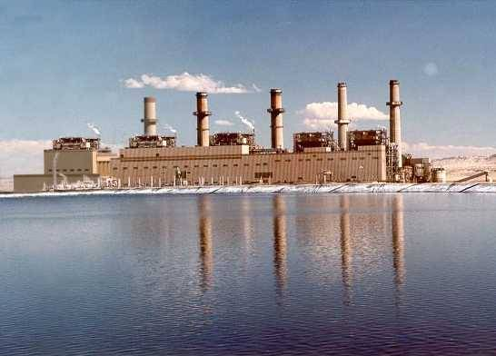
San Juan Generating Station
Early Retirement
SNCR Upgrades
  Operator: Public Service of New Mexico
  Location: Farmington, New Mexico
  In Service: 1973, 1976
  TEP’s Share is 340 MW
Regional Coal Capacity Reduction of 840 MW by 2018 (Proposed Plan)
TEP’s Reduction is 170 MW
EPA Regulatory Status
  On August 22, 2011 the EPA issued a decision requiring SJGS to install SCRs within 5 years, by September 21, 2016 at an estimated cost of $800-$900 million
  The decision has been challenged in court and the parties to that litigation developed an alternative to installing SCRs
  New Mexico EIB recently approved the alternative plan to shut down 2 units and install SNCR on the remaining 2 units by the end of 2017
  Awaiting EPA approval
Under the new proposal TEP would have to invest
approximately $30 million in Selective Non-Catalytic
Reduction technology
This proposed plan reduces TEP’s investment at San Juan by $170 million

Slide 4
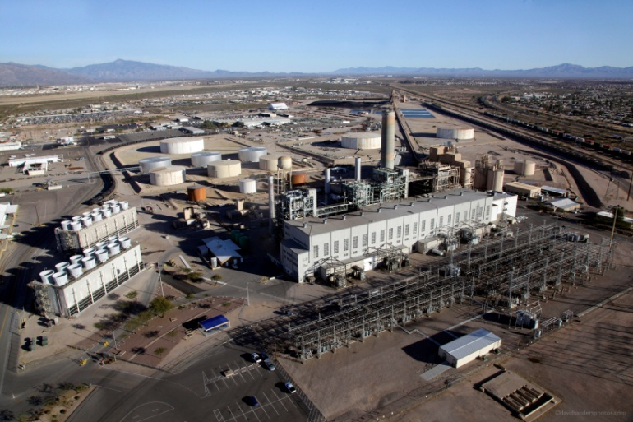
Sundt Unit 4
Proposed permanent
conversion to Natural Gas
Existing Natural Gas
Operator: Tucson Electric Power
Location: Tucson, Arizona
In Service: 1967, Converted to Coal in 1986
Units 1 – 3 Operate on Natural Gas
Regional Coal Capacity Reduction of 125 MW by 2018
EPA Regulatory Status
Unit 4 runs on either coal or gas
EPAs proposal would require TEP to invest approximately $130 million in Selective Catalytic Reduction (SCR) technologies
TEP’s gas conversion proposal will avoid approximately $110 million dollars in upgrade costs
  February 2011 - Arizona Regional Haze Plan, units reconstructed outside of BART time frame (1962-1977) are not BART eligible
  December 2012 - EPA disapproved decision regarding Sundt Unit 4. Sundt Unit 4 deemed BART eligible.
  Preliminary EPA BART analysis could cost $130 million to retrofit with SCR technology
  November 2013 - TEP submits plan to EPA to eliminate coal at Sundt by end of 2017
  EPA accepted the alternative proposal in Q1 2014

Slide 5
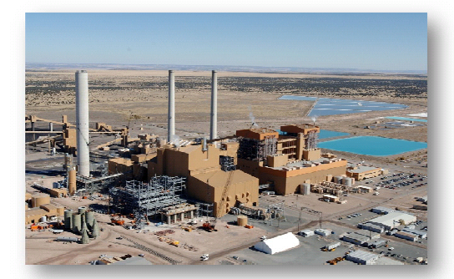
Springerville Unit 1
Non-TEP Ownership
TEP Ownership
  Newest / lowest cost coal resource in TEP’s generation fleet
  Outstanding unit availability factor, operated and maintained by TEP
  Competitive fuel supply options (rail access)
  Critical resource in-terms of transmission and ancillary services
  Not subject to current Regional Haze regulations
  TEP currently owns 55MW or 14% of Unit 1
  TEP exercised its purchases options on 135 MW at $478/kW ($65M)

Slide 6
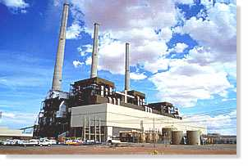
Navajo Generating Station
Early Retirement
SNCR Upgrades
  Operator: Salt River Project
  Location: Page, Arizona
  In Service: 1974, 1975 & 1976
  TEP’s Share is 168 MW
Regional Coal Capacity Reduction of 750 MW by 2020 (Proposed Plan)
EPA Regulatory Status
Under new proposal TEP would have to invest
approximately $85-100 million (2026-2031) in
pollution controls
This plan gives the remaining owners the flexibility to consider future alternatives
  EPA issued decision requiring SCR on all 3 units by 2018
  SCR installation estimated at over $500 million
  May be significantly more if baghouses are required
  Technical Work Group formed to consider alternatives
  Proposal to shut down one unit by 2020 and install SCR (or new technology) by 2031

Slide 7
Impacts on TEP’s Coal Capacity
Coal Capacity Reduction Commitments
Coal Capacity at Risk for Early Retirement
Coal Capacity Commitments
Better than BART Alternative
Still Pending
Better than BART Alternatives Finalized

Slide 8
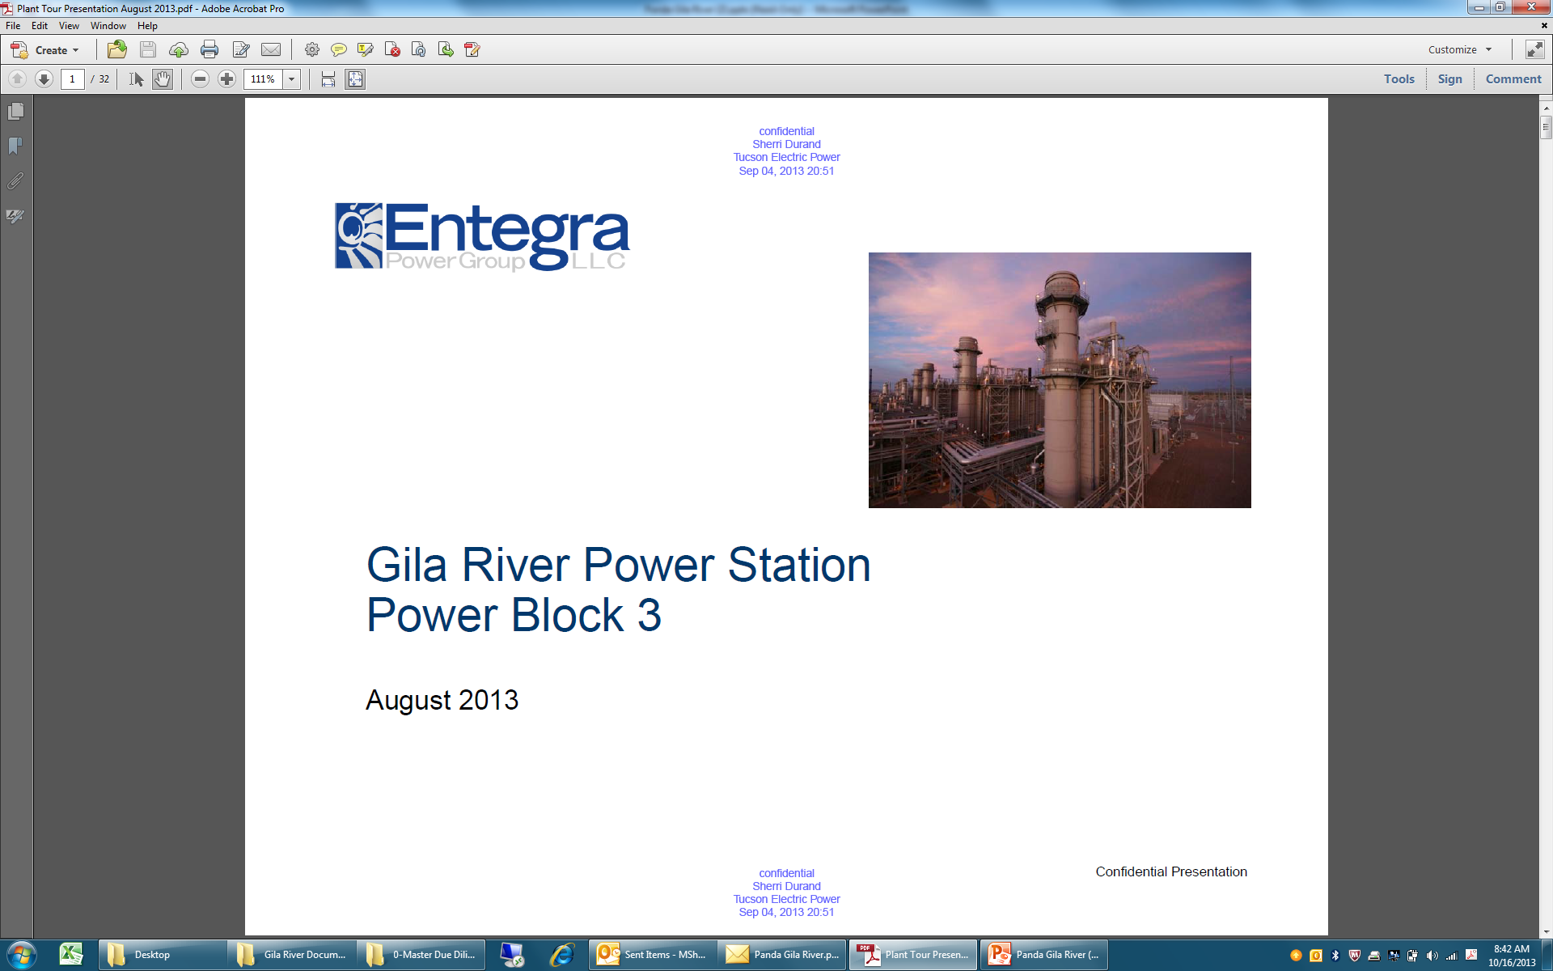
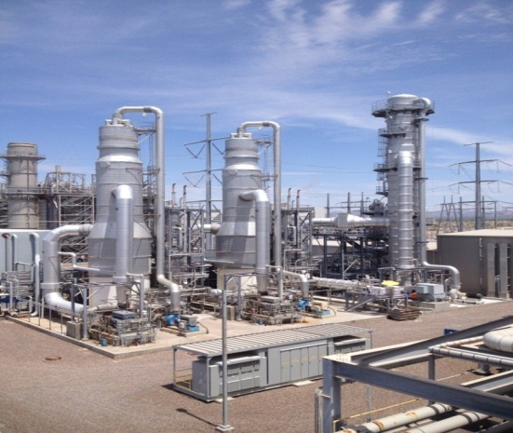
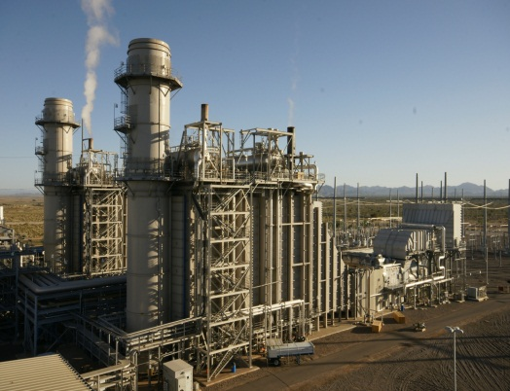
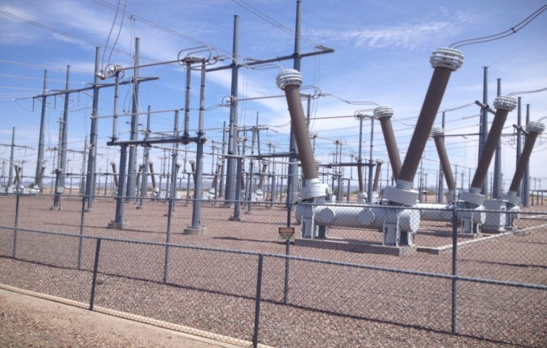
75% Ownership Share (412 MW)
$165 Million ($398/kW)
1/3 Cost of New Build NGCC
    $218M NPV benefit to TEP customers vs. other alternatives

Slide 9
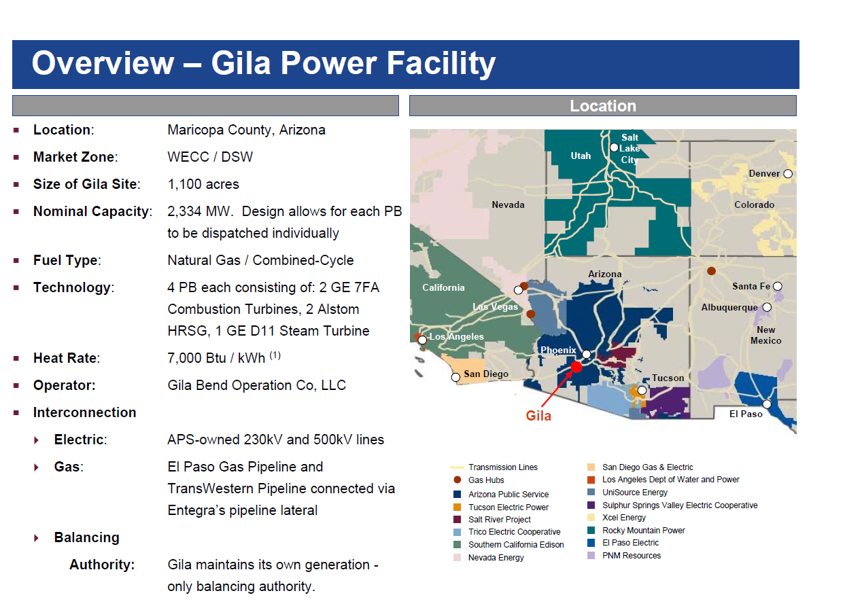
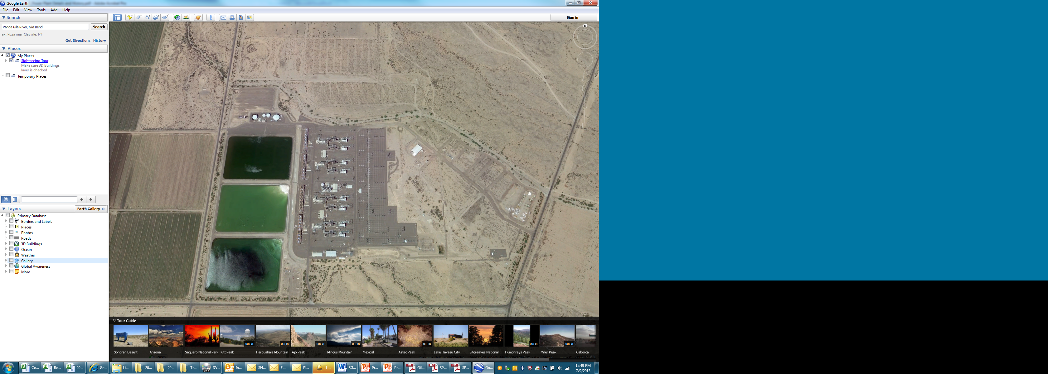

Slide 10
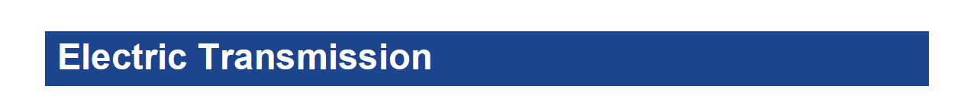
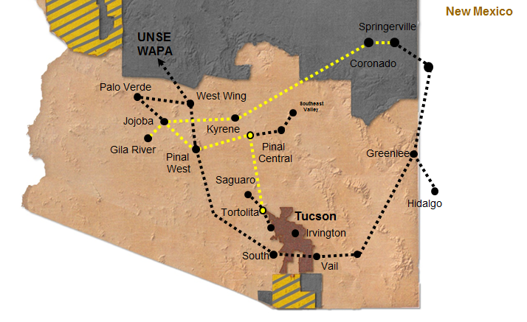
Transmission access to TEP and UNSE retail service territories
TEP - Firm Transmission Rights to Springerville and Tortolita (Post 2016)
UNSE - Firm Transmission Rights to WAPA to take delivery into Mohave and Santa Cruz counties

Slide 11
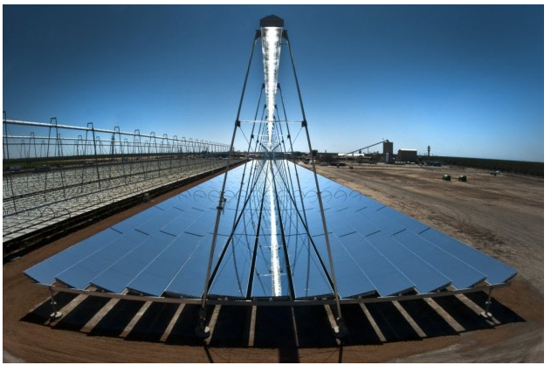
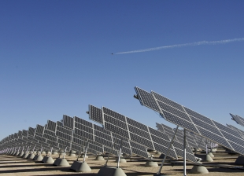
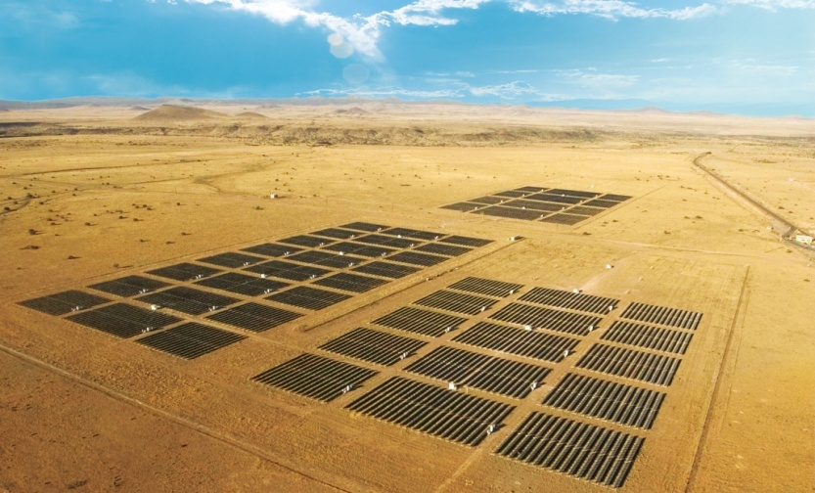


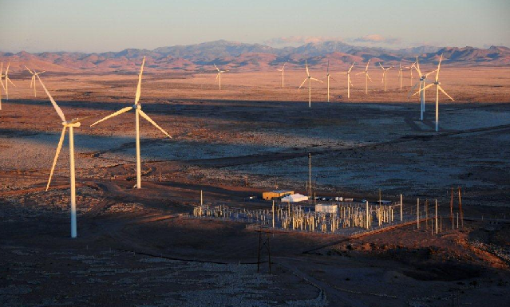

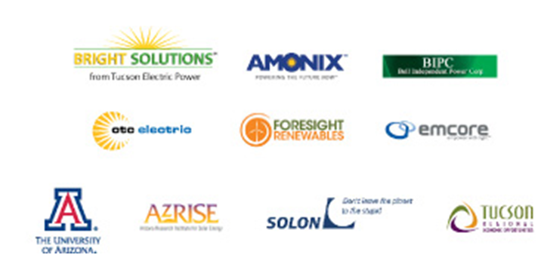
TEP Renewable Resources
Single Axis Tracking Systems 45 MW
U of A Science & Tech Park
Foresight & Sun Edison Projects
Sundt
Power Boost
CSP Project 5MW
Future 2014
Flat Panel PV 40 MW
Springerville
NRG Solar
Concentrated PV 4 MW
U of A Science & Tech Park
Emcore
Wind 50 MW
Macho Springs
Red Horse (2015)

Slide 12
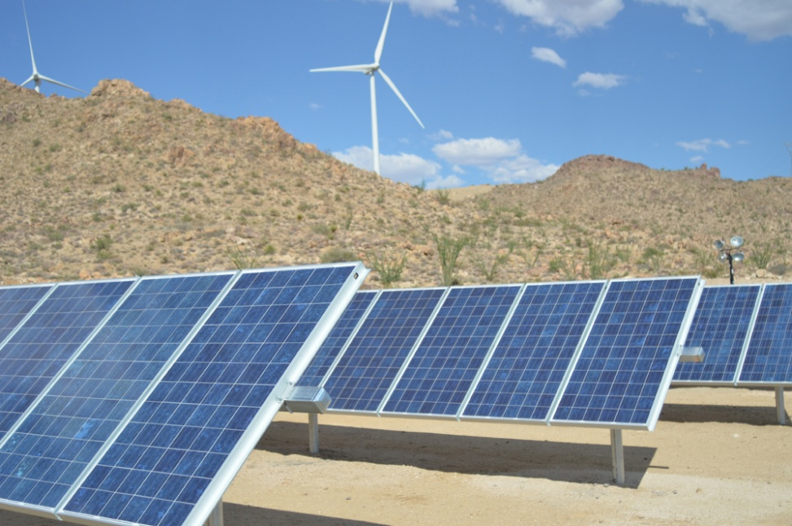
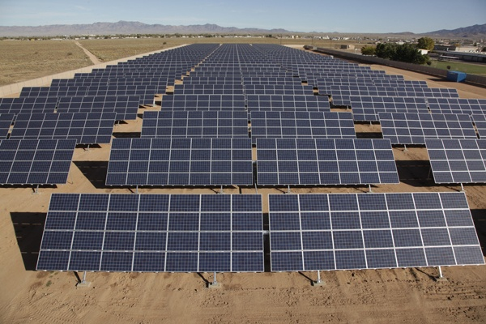
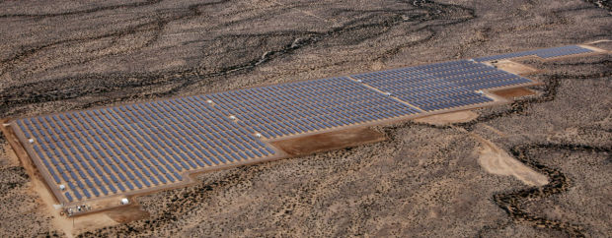
UNSE Renewable Resources
Western Wind
Wind & Solar Project 10.5 MW
La Senita Solar
Solar Project 1.2 MW
Solon BMGS
Single Axis Tracking Project 10 MW

Slide 13
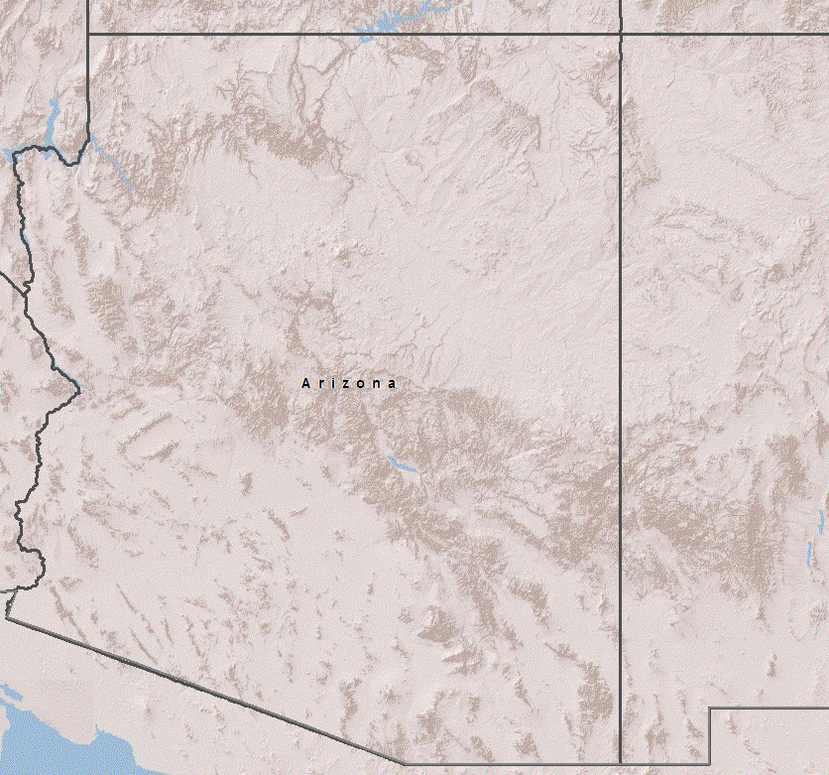
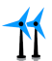

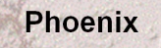
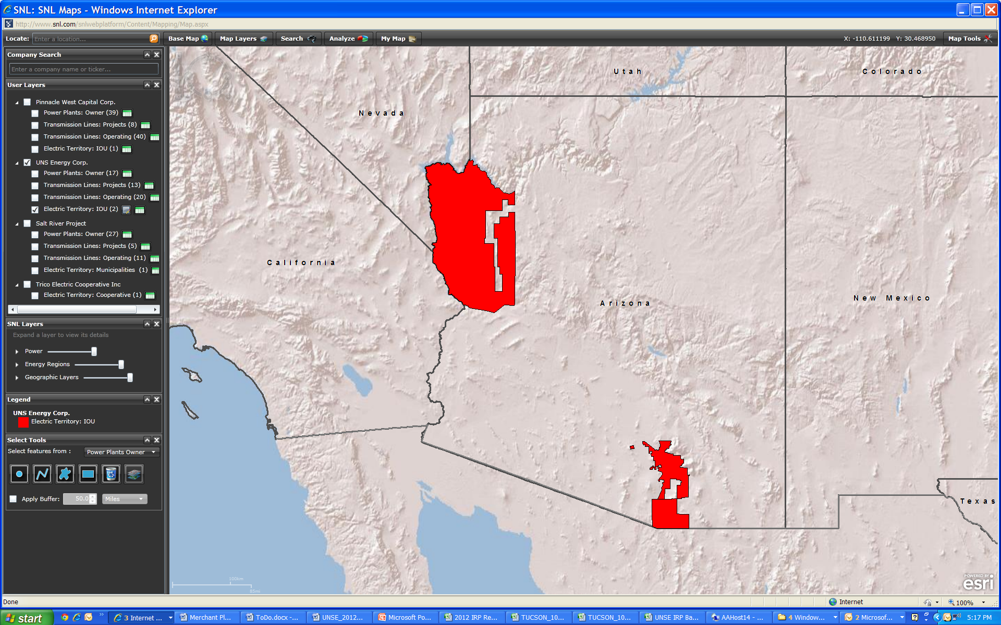

TEP and UNSE Renewable Resources
Resource- Counterparty | Technology | Capacity MW
Sexton Energy | Landfill Gas | 2.2
Springerville | Fixed PV | 6.4
Solon UASTP III | Fixed PV | 5
Astrosol UASTP IV | Fixed PV | 6
Solon Prairie Fire | Fixed PV | 5
NRG Solar Avra Valley | Fixed PV | 35
TEP Warehouse | Fixed PV | 0.5
Ft Huachuca | Fixed PV | 17.6
Western Wind and Solar | Fixed PV | 5
Black Mountain Solar | Fixed PV | 10
La Sienita | SAT PV | 1.2
Solon UASTP I | SAT PV | 1.6
E.On UASTP | SAT PV | 6.6
FRV Picture Rocks | SAT PV | 25
E.On/TEP Valencia | SAT PV | 13.2
Amonix UASTP II | CPV | 2
Macho Springs | Wind | 50.4
Western Wind and Solar | Wind | 5
Pima Mine Rd (Planned) | SAT PV | 28
Red Horse 2 (Planned) | Fixed PV | 30
Red Horse 2 (Planned) | Wind | 40
Total Renewable Resources |  | 296
Solon BMGS
10 MW
Western
Wind
10 MW
Distributed
Generation
10 MW
New Mexico
La Senita
1.2 MW
Springerville 7 MW
Future Wind
Optionality
With Coal Retirements
Palo Verde
TEP
345 kV
NRG Solar
32 MW
Distributed
Generation
60 MW
Yuma
Macho Springs
50 MW
Red
Horse
50 MW
(2015)
Sun Edison
25 MW
U of A Tech Park
35 MW

Slide 14
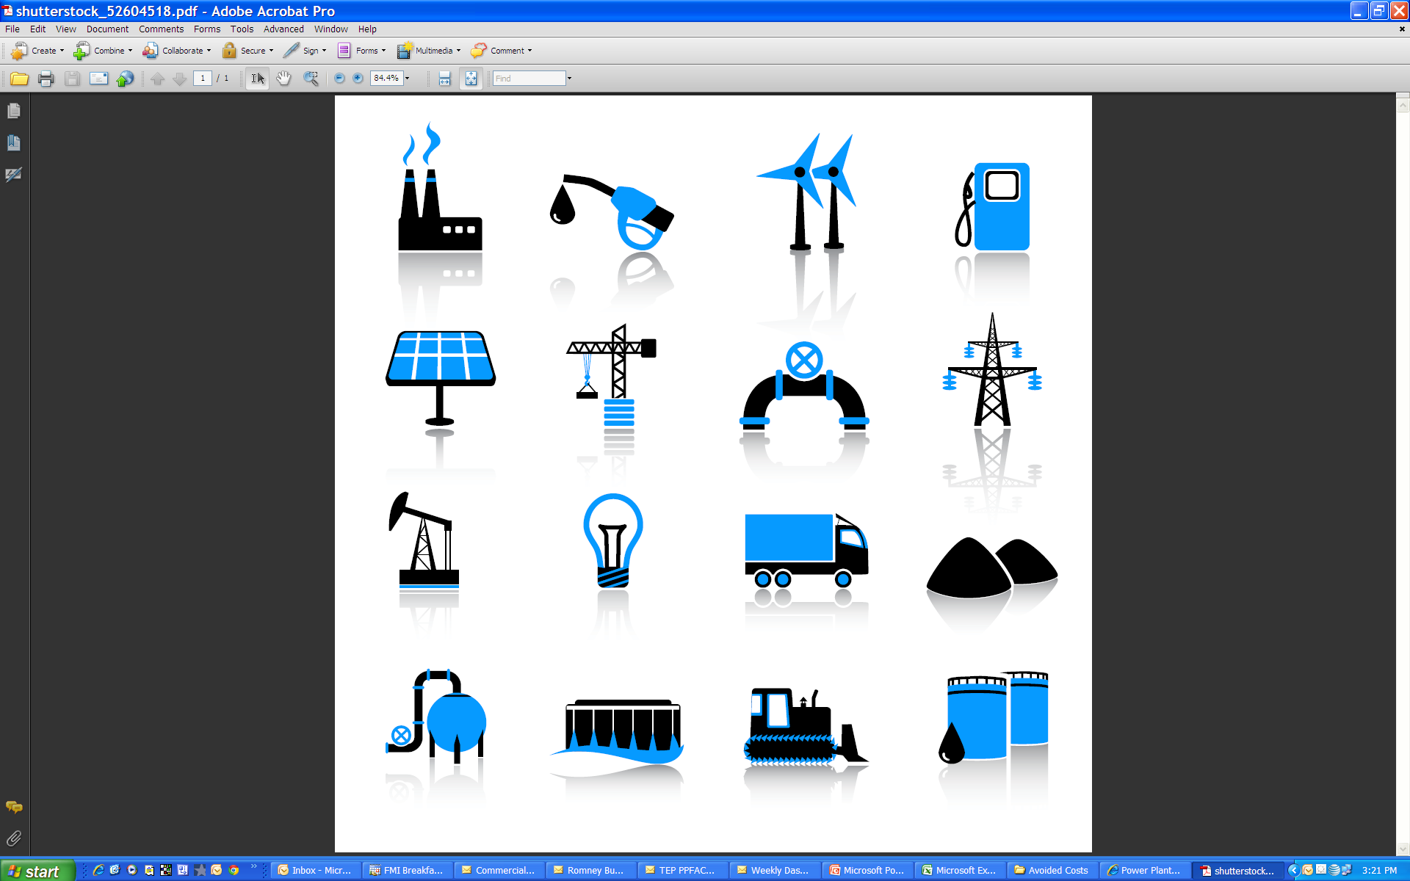
TEP Renewable Energy Standard
Utility Scale Renewables
Distributed Generation
170 MW
225 MW
300 MW
400 MW
2014 2016 2018 2020 2022 2024 2026 2028
70 MW
150 MW
200 MW
250 MW

Slide 15
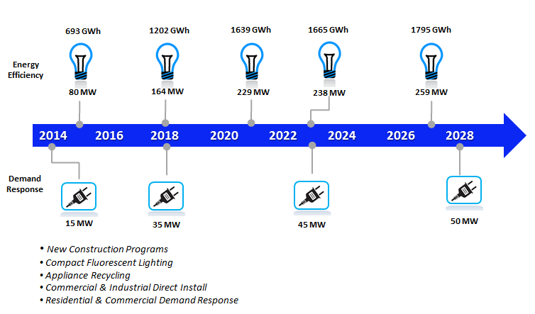
TEP Energy Efficiency Standard

Slide 16
2014 Reference Case Environmental Improvements
Peak
2020
15% vs. Today
29% vs. System Peak
Peak
Today
Today
2020
34% vs. Today
68% vs. System Peak
Peak
Peak
Today
2020
16% vs. Today
32% vs. System Peak
Today
2020
9% vs. Today
80% vs. System Peak

Slide 17
TEP Reference Case Loads & Resource Forecast
2015
Acquire New Natural Gas Combined Cycle Resource
(Increase of 413 MW)
2018
Sundt Unit 4 Planned Commitment to Natural Gas
(Reduction of 125 MW Coal)
Peak Demand Net Energy
Efficiency and Distributed Generation
With a 15% Planning Reserve Margin
Future Gas Resources
Gila River
Power Station
Existing Natural Gas Resources
2015
Springerville Unit 1
Lease Expiration
(Reduction of 197 MW of Coal)
2018
San Juan Unit 2 Retirement
(Decrease of 170 MW of Coal)
Existing Coal

Slide 18
TEP Reference Case Loads & Resource Forecast
2015
Acquire New Natural Gas Combined Cycle Resource
(Increase of 413 MW)
2018
Sundt Unit 4 Planned Commitment to Natural Gas
(Reduction of 125 MW Coal)
Peak Demand Net Energy
Efficiency and Distributed Generation
With a 15% Planning Reserve Margin
Future Gas Resources
Gila River
Power Station
Existing Natural Gas Resources
2015
Springerville Unit 1
Lease Expiration
(Reduction of 197 MW of Coal)
2018
San Juan Unit 2 Retirement
(Decrease of 170 MW of Coal)
Existing Coal

Slide 19
TEP Reference Case Loads & Resource Forecast
2015
Acquire New Natural Gas Combined Cycle Resource
(Increase of 413 MW)
2018
Sundt Unit 4 Planned Commitment to Natural Gas
(Reduction of 125 MW Coal)
Peak Demand Net Energy
Efficiency and Distributed Generation
With a 15% Planning Reserve Margin
Future Gas Resources
Gila River
Power Station
Existing Natural Gas Resources
2015
Springerville Unit 1
Lease Expiration
(Reduction of 197 MW of Coal)
2018
San Juan Unit 2 Retirement
(Decrease of 170 MW of Coal)
Existing Coal

Slide 20
2014 Reference Case - Energy Portfolio
2014 Portfolio Energy Mix
2020 Portfolio Energy Mix

Slide 21
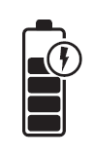
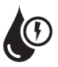
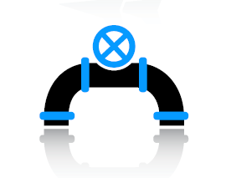
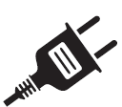
2014 IRP Reference Case Plan
-197 MW
Reduce TEP’s Coal Commitments on Springerville Unit 1
Pinal Central
Tortolita
500kV EHV
-170 MW
Retire TEP’s Share of San Juan Unit 2
Natural Gas Resources
Energy Storage
Future Support for Intermittent Resources
2015 2017 2018 2021 2023
400 MW
Acquire Gila River
Combined Cycle Plant
-120 MW
Commit
Sundt Unit 4
to Natural Gas
Fully Compliant with Arizona Energy Efficiency Standard
22% by 2020
Fully Compliant with Arizona Renewable Energy Standard
15% by 2025
2018
Sundt Natural Gas Conversion

Slide 22

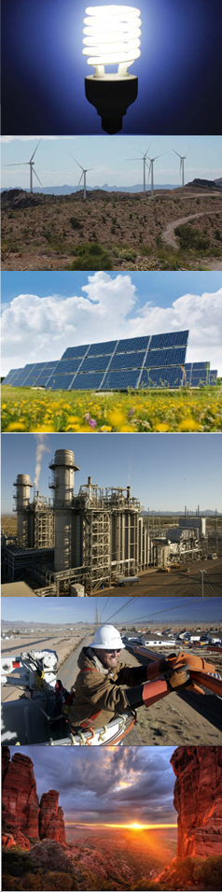
2014 UNSE Reference Case
Mike Sheehan
Director of Resource Planning
2014 Integrated Resource Plan

Slide 23
Key 2014 IRP Messages for UNSE
UNSE Portfolio Diversification Strategy
  Improved Transmission Reliability
    Vail to Valencia 115kV to 138kV upgrade
  Gila River Power Station
    Reduction in reliance on Market Based Capacity
    Sized to fulfill existing baseload and intermediate capacity needs
    Joint ownership synergies with TEP
    Low cost generation resource for UNSE customers ($398/kW)
    $44M NPV benefit to UNSE customers vs. other alternatives
Planning for Future Renewable Integration
  Need for fast ramping gas fired resources
  Introduction of future storage and smart grid technologies

Slide 24
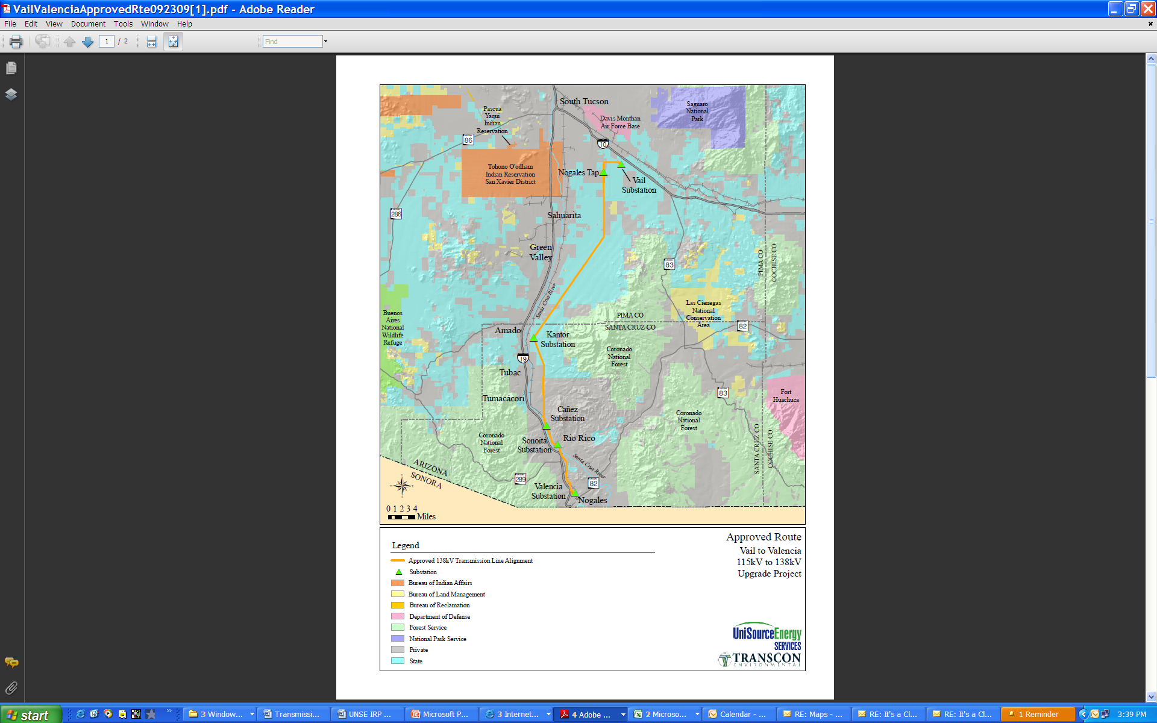
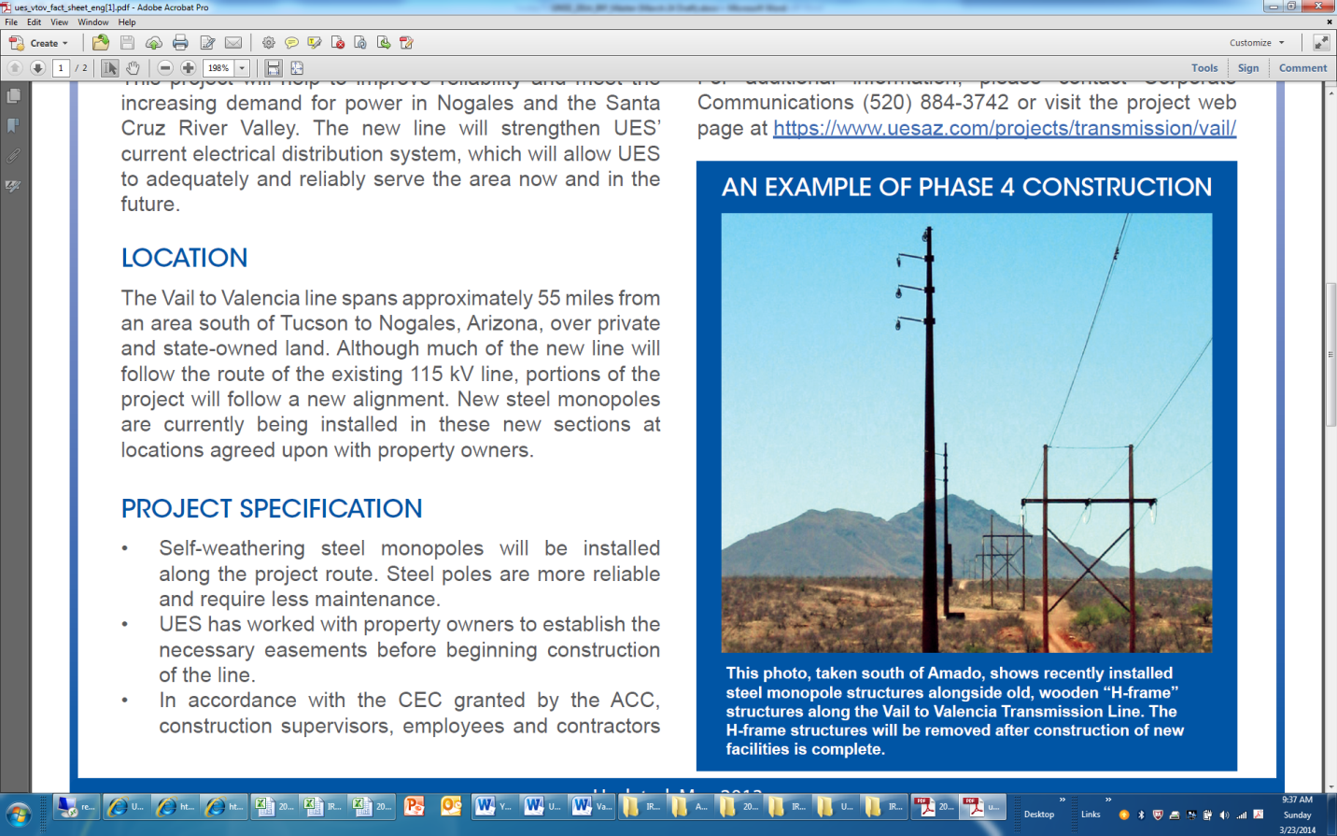
    Valencia 115kV to 138kV Upgrade
$14M – 115 kV to 138 kV Upgrade
Increased Transmission Reliability
New Steel Pole Construction
Increased Import Capability
Reduced Reliance on Must-Run Generation in Nogales, Arizona

Slide 25
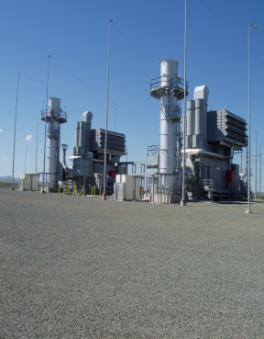
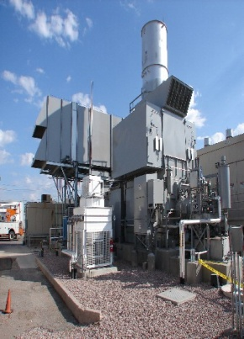
UNSE Generation Resources
Kingman
Black Mountain
90 MW
Lake Havasu
New Mexico
Black Mountain Generating Station
90 MW Natural Gas Combustion Turbines
Palo Verde
TEP
345 kV
Gila River
138 MW
Yuma
Tucson
Nogales
Valencia
66 MW
Valencia Generating Station
66 MW Natural Gas Combustion Turbines

Slide 26
25% Ownership Share (138 MW)
$55 Million ($398/kW) 1/3 Cost of New Build NGCC
Transmission access to both Mohave and Santa Cruz counties
Operational synergies with TEP
Rare opportunity to acquire (baseload, intermediate resource) without significant rate impacts.
30% reduction in both capacity and energy exposure to the merchant wholesale market.

Slide 27
UNSE Renewable Energy Standard
Utility Scale Renewables
Distributed Generation
20 MW
50 MW
65 MW
80 MW
2014 2016 2018 2020 2022 2024 2026 2028
10 MW
20 MW
30 MW
50 MW

Slide 28
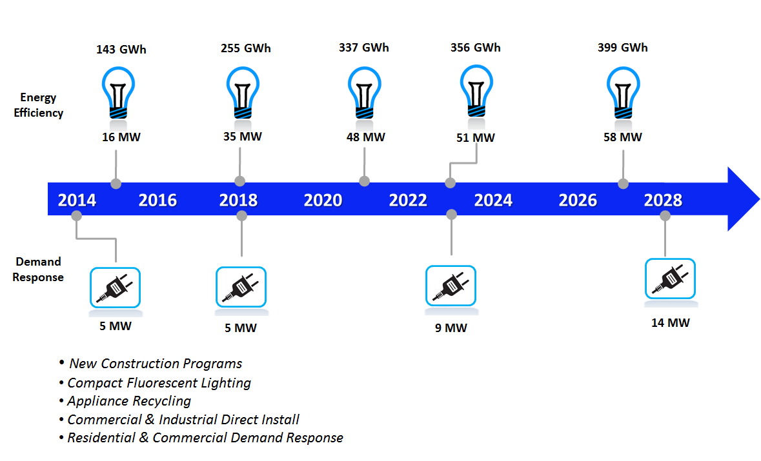
UNSE Energy Efficiency Standard

Slide 29
UNSE Loads & Resource Forecast (Before Gila River)
Peak Demand Net Energy
Efficiency and Distributed Generation
With a 15% Planning Reserve Margin
Annual capacity exposure approximately 200 to 300 MW during the Summer Peak

Slide 30
UNSE Loads & Resource Forecast (After Gila River)
Peak Demand Net Energy
Efficiency and Distributed Generation
With a 15% Planning Reserve Margin
Peaking
Requirements
UNSE Remaining
Procurement Requirements
Intermediate
Requirements
Base Load
Requirements

Slide 31
Reducing UNSE’s Reliance on Market Resources
Resource Capacity
Prior to Gila River Acquisition
Resource Capacity
After to Gila River Acquisition

Slide 32
2014 UNSE IRP Reference Case Plan
138 MW
Acquire Gila River
Combined Cycle Plant
21 MW Combustion Turbine
(Santa Cruz)
Vail to Valencia 115kV – 138kV Conversion
Natural Gas Resources
Energy Storage
Future Support for Intermittent Resources
2014 2016 2018 2020 2022 2024 2026 2028
Fully Compliant with Arizona Energy Efficient Standard
22% by 2020
Fully Compliant with Arizona Renewable Energy Standard
15% by 2025

Slide 33

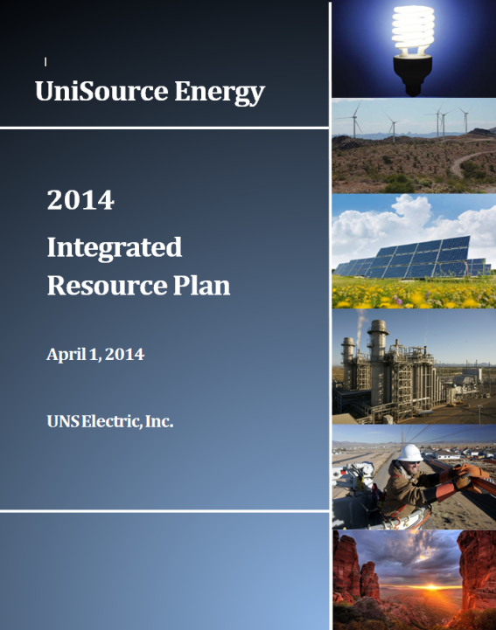
2014 Integrated Resource Plans
Full write-up located at https://www.tep.com/projects/planning/

