Slide 1
2014 Integrated Resource Plan
Arizona Corporation Commission
Workshop
September 11, 2014
Jim Wilde
Director, Resource Planning

Slide 2
2014 IRP Supplement
Modify chosen portfolio from the Selected Portfolio (April 2014 Selected Portfolio) to the Coal Reduction Portfolio (September 2014 Selected Portfolio)
Currently in talks with EPA, ADEQ and PacifiCorp to craft a resolution for Cholla:
  Retire Unit 2 in 2016
  Retire Units 1 and 3 in mid-2020’s (at end of coal contract) or convert to natural gas
Modification based on economics of required environmental upgrades to comply with MATS and Regional Haze
  Similar to Four Corners 1-2-3, environmental upgrades cannot be supported given lack of economies of scale
Portfolio modification will produce cost savings to customers and reduce environmental impacts
IRP Supplement will be filed with the ACC
2

Slide 3
2014 IRP Summary
2014
Natural gas generation will play increasingly important role
  Economics
  Operational flexibility
Cleaner energy mix
  Customer resources such as roof-top solar and energy efficiency projected to triple
  Environmental regulations
Advanced technology will change the electricity grid
  Integration of renewable energy
  Communication and automation
2029
3

Slide 4
Supply-Demand Gap
Growth in customer energy requirements expected to resume
Customer resources expected to triple over planning horizon
Expiring purchase contracts means APS will need additional resources by 2017
Additional resource needs anticipated to be met by increasingly diverse and efficient technologies
Demand Requirements
New Customer Resources
Existing Contracts
New Utility-Scale Resources
Existing Resources
4

Slide 5

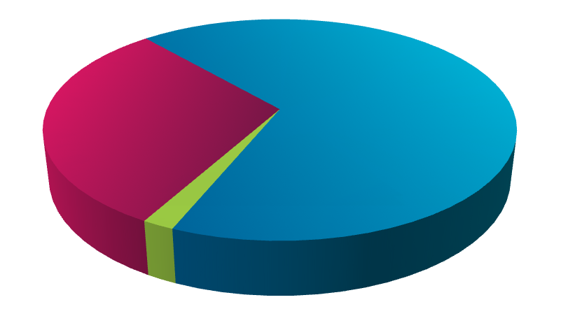
Expected Future Resources
Sept 2014 Selected Portfolio
2014-2029 (Forecast)
Future Additional Resources
7,267 MW Expected at Peak
a. New Utility-Scale Resources
Natural Gas
4,817 MW
Renewable Energy
467 MW (1,018 MW nameplate capacity)
New Customer Resources
Energy Efficiency
1,447 MW
Distributed Energy
261 MW (722 MW nameplate capacity)
Demand Response
275 MW
Existing Utility-Scale Resources
a
New Utility-Scale Resources
Existing Contracts
b
New Customer Resources
Existing Customer Resources
a
b
2014
8,124 MW
peak requirement
100% met with existing resources
2029
12,982 MW
peak requirement
45% met with
existing resources
5

Slide 6
Portfolios Considered
2029 Capacity Comparison
Sept 2014 Selected Portfolio is being chosen because it provides better combination of:
  Overall cost
  Operational flexibility to support grid reliability and renewable energy integration
Provides for discussion of uncertainties in upcoming coal fleet decisions
14,111
Energy Efficiency & Demand Response
Coal
Renewable Energy (nameplate)
Nuclear
* Coal Reduction Portfolio
Natural Gas
6

Slide 7
Energy Mix
2014 vs 2029 Comparison
Of the four portfolios considered, all have a diverse resource mix
Renewables and coal primary resources being flexed in portfolio analysis
Natural gas resources used to balance out remaining needs by providing summer capacity and operational flexibility
Energy Efficiency & Demand Response
Coal
Renewable Energy
Nuclear
* Coal Reduction Portfolio
Natural Gas
7

Slide 8
Comparative Revenue Requirements
Differences from Apr 2014 Selected Portfolio in 2029
Portfolio | 2029 Revenue Requirement $BB (NPV)
Apr 2014 Selected | $29.3
Enhanced Renewable | $29.9
Sept 2014 Selected* | $29.2
Coal-to-Gas Conversion | $29.3
+$634 MM
+$29 MM
Apr 2014 Selected Portfolio
- $106 MM
Enhanced Renewable Portfolio
Sept 2014 Selected Portfolio*
Coal-to-Gas Conversion Portfolio
* Coal Reduction Portfolio
8

Slide 9
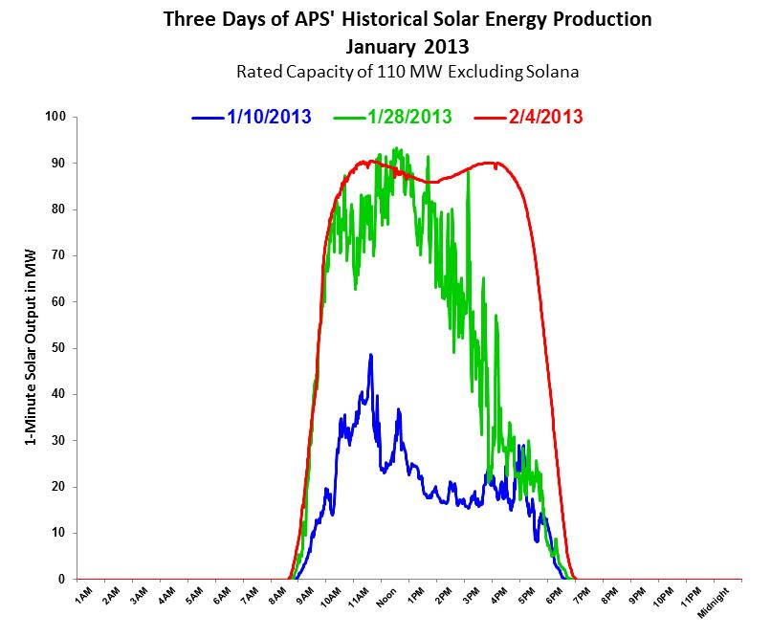
Evolving Customer Demand
Growth of solar PV changes customer energy consumption patterns
Generators must be able to start and stop multiple times per day
Fast starting and ramping capability is required in responding to intermittent output of renewable resources
9

Slide 10
Variability Requires Flexibility
Balancing Growth at Both Ends of Flexibility Spectrum
CC
CT
DE
EE
Nuclear
Geothermal
Biogas
Biomass
Coal
DR &
Options
Solar PV
Wind
Capacity (MW)
+
CSP with
storage
Gas Steam
Storage
0
-
Variable/Inflexible
Less Flexible
Semi-flexible
Flexible
10

Slide 11
Future Technology Drivers
Transition Towards Integrating Evolving Energy Resource Portfolio
System Drivers
  Increasing amounts of intermittent generation
  Need for peaking resources and summer time capacity
  Cost of compliance with environmental regulations
  Stable natural gas prices
Potential Benefits
  Increased resource diversity
  Flexible gas generation meets peak needs and enables renewable energy integration
  Reduced environmental impacts
Potential Risks
  Cost of resource diversity for newer technologies
  Technology maturity and uncertain reliability
  Maintaining balance between variable/inflexible resources and flexible resources
Potential value of storage
11

Slide 12
Sample of Potential Future Energy Storage Options
Battery Storage
  Uses off-peak/dump energy from grid to charge battery
  Discharges energy when needed
Flywheel/Rotary Uninterruptible Power Supplies (UPS)
  Very short-term energy and voltage stabilization
Pumped Hydro
  During periods of high demand, power is generated by releasing water from an upper reservoir through turbines in the same manner as a conventional hydropower station
  During periods of low demand, the upper reservoir is recharged by using lower-cost electricity from the grid to pump water from a lower reservoir back to the upper reservoir
Compressed Air Energy Storage (CAES)
  CAES potential in helping provide back up for solar and wind generation
  Geologic and permitting concerns
12

Slide 13
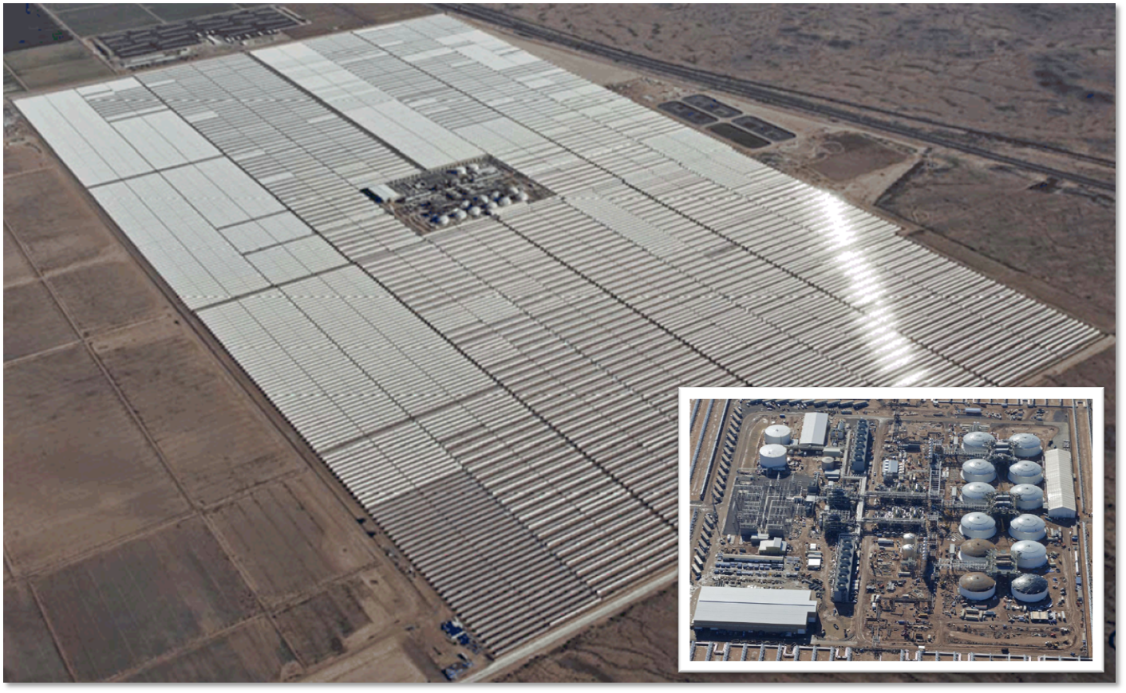
Solana – Energy Storage Today
Developer - Abengoa
Location – 10 miles west of Gila Bend, AZ
Capacity/Generation – 250 MW, annual energy approximately 900,000 MWhs
In-Service – October, 2013
Thermal energy storage
  Six hours at full capacity
  Increased hours of storage at lower capacity levels
100% solar power availability at time of peak
  Solar PV has reduced levels of capacity at time of peak
Operational flexibility
  Start before sunrise and run for morning peak by holding energy in storage from previous day
  Continue to run for evening peak (after sunset)
13

Slide 14
Battery Storage vs Equivalent CT Costs
Primary technologies
  Sodium Sulfur (NaS)
    15 year battery life, 6 hour capability
  Sodium Nickel Chloride (NaNiCl)
    15 year battery life, 5 hour capability
  Lithium Ion (Li-Ion)
    15 year battery life, 5 hour capability
Not a viable capacity solution at this time
  High costs relative to other options
  Value will increase as reliability is proven and costs come down
  Limited number of utility scale sites
  Will be evaluated in future IRPs
  Significant resource needs for 2019 and beyond
  Near term opportunities for pilot projects
$ Millions/year
Source: DOE/EPRI 2013 Electricity Storage Handbook
14

Slide 15
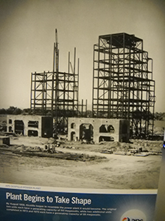
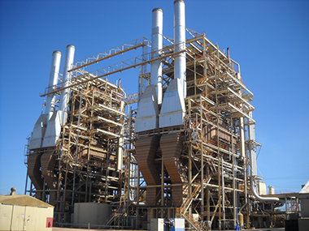
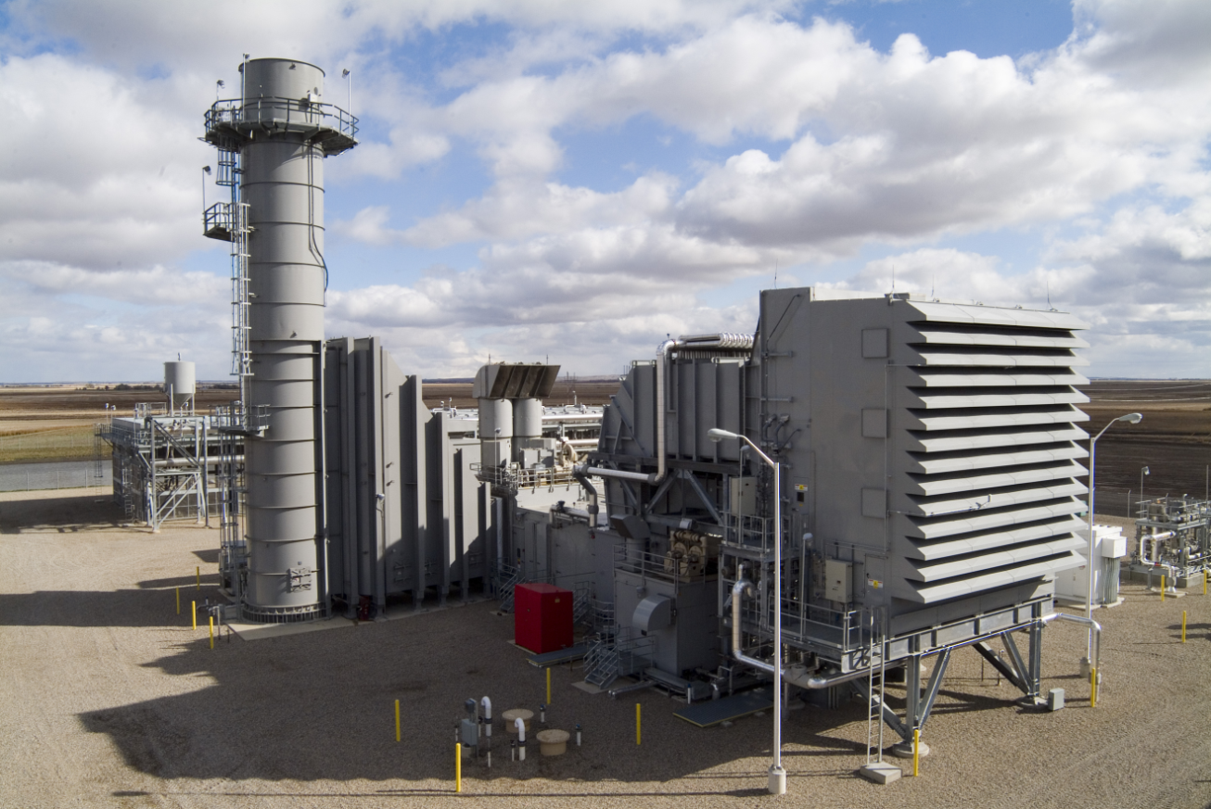
Ocotillo Modernization Project
Retire aging, large steam units constructed in 1960
Replace steam units with modern technology
Maintain Valley reliability
Responsive unit operations
Environmental attributes
In-service planned for summer 2018
15

Slide 16
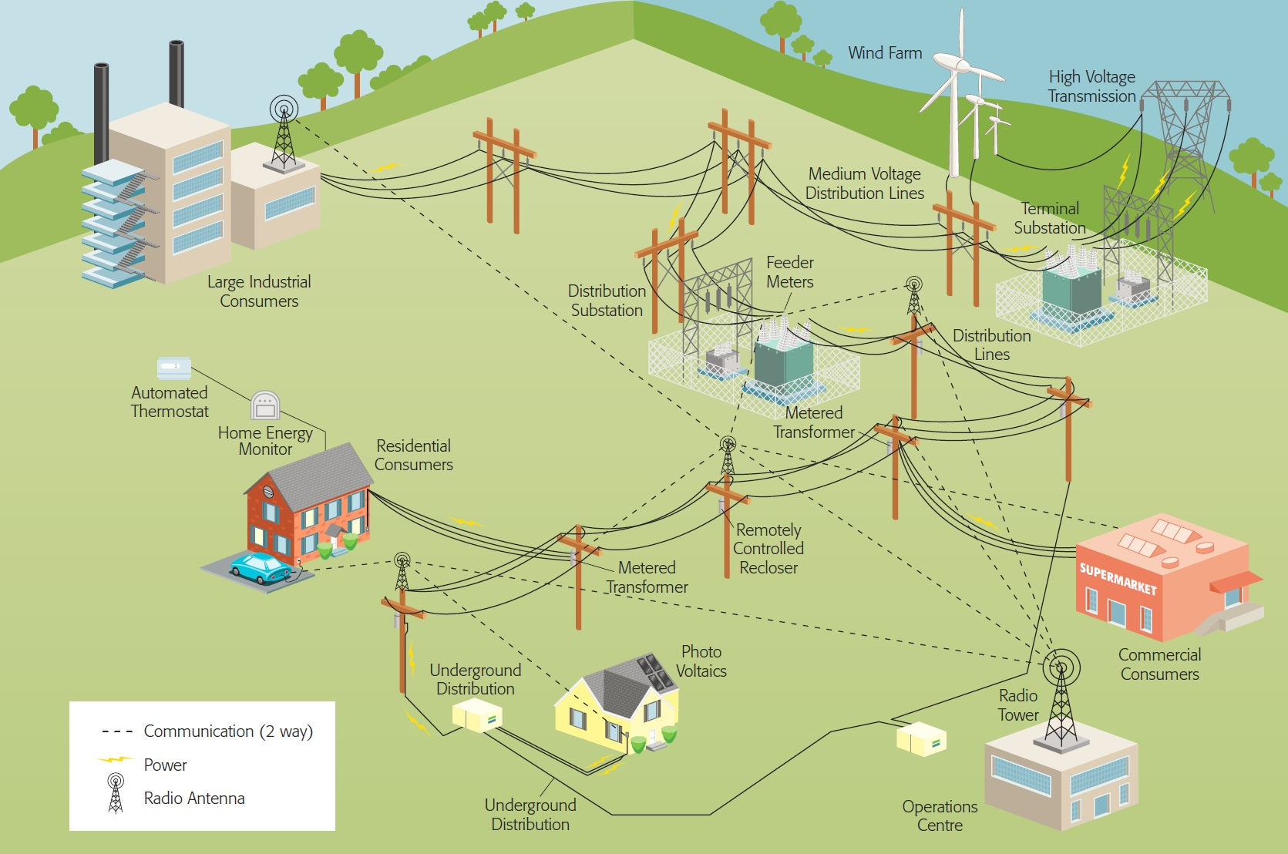

Proliferation of Distributed Generation
Demands A More Advanced Grid
Fiber Backhaul
Demand Response
Substation Health Monitoring
TOAN
TOAN
Integrated Volt/VAR Control
Fault Indicators
AMI
Automated Switches
ADMS EMS
Transformer Load Management
AMI Solar Production Meters
16

Slide 17

www.aps.com/resources www.azenergyfuture.com
17

Slide 18
APPENDIX
18

Slide 19
Incremental Near-Term Natural Gas Resource Needs
Of the 3,800 MW needed by 2021, the 2014 IRP calls for 2,400 MW to come from natural gas resources
  Capacity from Ocotillo Project represents roughly 20% of near term natural gas resource needs, and roughly 13% of total need
  Significant reliance on markets
19
Notes:
BULL PEN slide

Slide 20
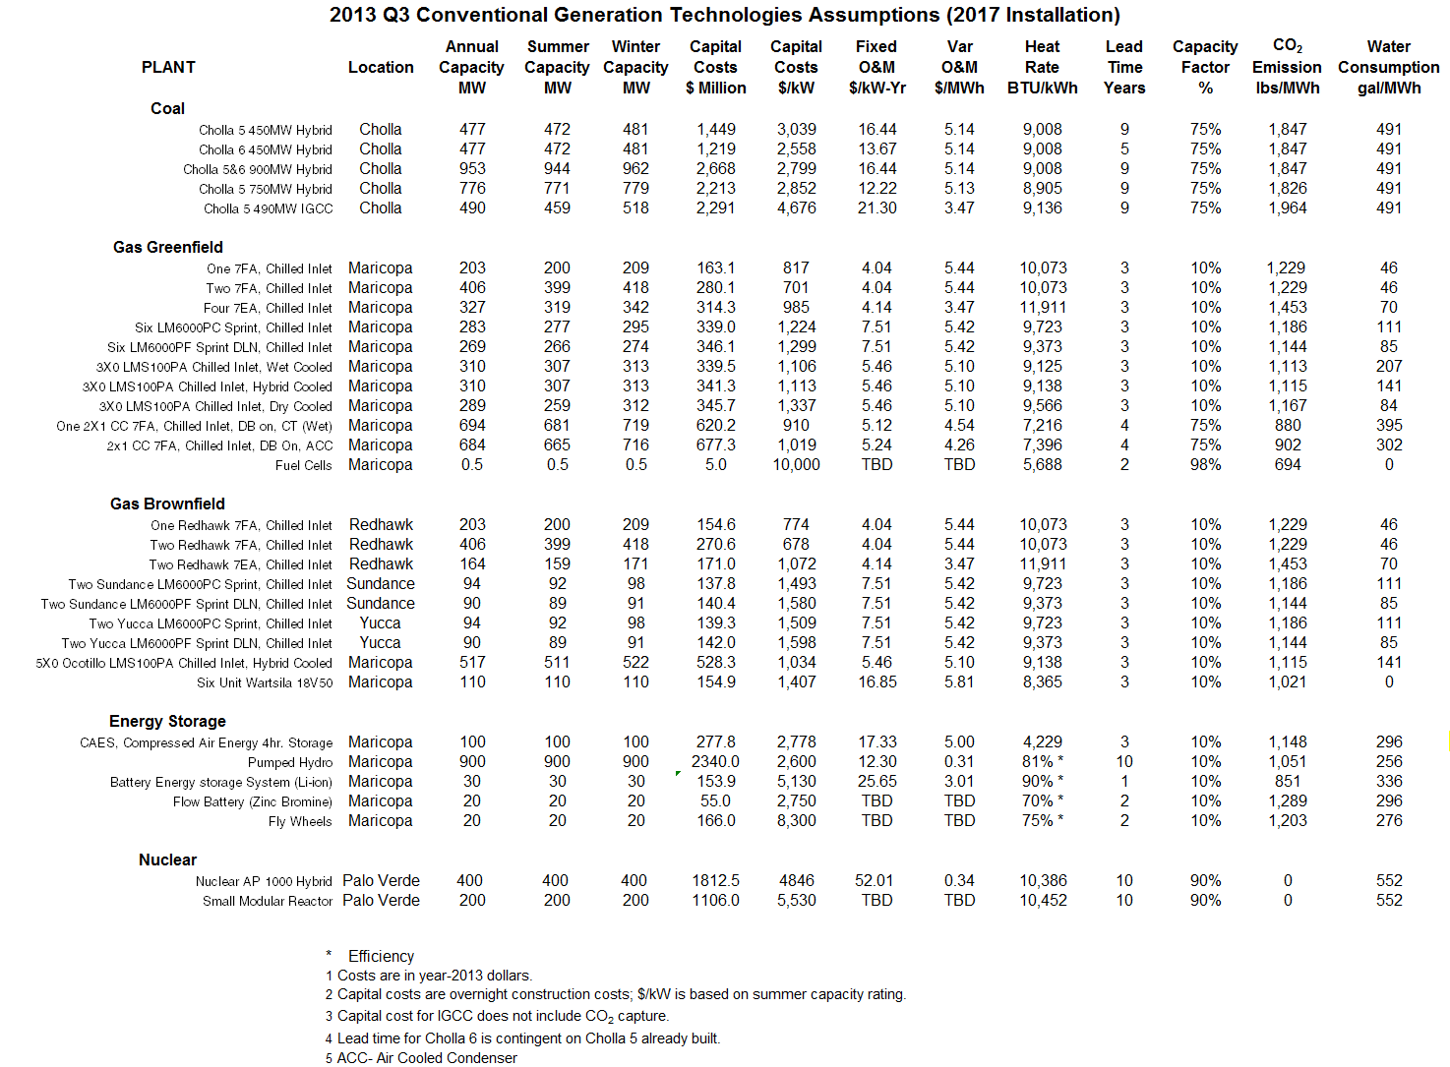
20

Slide 21
Potential Future Resource Technologies
Nuclear (SMR)
  Small modular reactors (SMR) will be nuclear technology of choice after 2025 (EIA)
  Typically smaller than 300 MW
  Built off-site in a modular arrangement, shipped to plant, and set up on plant foundation
Coal
  Ultra-supercritical steam turbines (USC) are an early commercial technology
  Integrated gasification combined cycle (IGCC) integrate coal gasification with combined-cycle technology
Solar Tower Systems
  Field array of mirrors reflect sunlight onto a central receiver located at top of tower
  Could be competitive with parabolic trough with thermal energy storage, if proven reliable & cost-effective
Fuel Cells
  Types include alkali (AFC), phosphoric acid (PAFC), molten carbonate (MCFC), proton exchange membrane (PEM), solid oxide fuel cell (SOFC), and direct carbon (DCFC)
  Unsuitable for distributed generation or smart-grid applications until reliability improves, costs are reduced, and cell-stack life is extended
Natural Gas (CC & CT)
  Clean burning
  Efficient
  Simple cycle combustion turbines (CT) have quick start & fast ramping capability
Customer-Side Resources
  Energy Efficiency (EE)
  Distributed Generation (DG)
21

Slide 22
Planning Considerations
Load Forecast
Regulation
Existing
Resources
Stakeholders
2014
IRP
Customer
Resources
Cost
Future Resource
Options
Environmental Impact
Reliability and Safety
22

