Slide 1
Arizona Electric Power Cooperative, Inc.
Integrated Resource Plan (IRP) Presentation to the Arizona Corporation Commission (ACC)
September 11, 2014

Slide 2
AEPCO’s Planning Obligations
Arizona Electric Power Cooperative, Inc. (AEPCO)
  Generation Owner and Provider for three All Requirements Members (ARM) and three Partial Requirements Members (PRM) Distribution Cooperatives.
  Power Supply Entity for all ARM needs, but only fixed contractual requirements for PRMs.

Slide 3


All Requirements Members
AEPCO provides Resource Planning in Arizona on behalf of its ARMs: Duncan Valley Electric Cooperative, Inc., (DVEC) and Graham County Electric Cooperative, Inc. (GCEC).

Slide 4



Partial Requirements Members
Each PRM that has a shortfall must resource plan on its own behalf.
Any PRM may contract with AEPCO to provide resource planning.

Slide 5
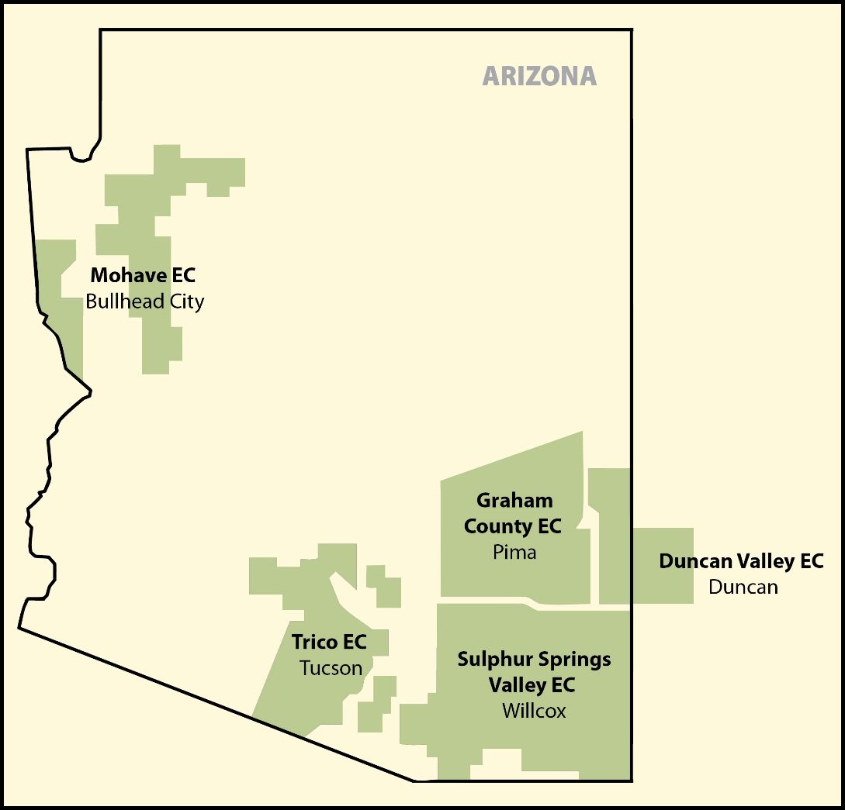
Service Territories Covered

Slide 6
Current AEPCO Resources
Steam Unit 2 (ST2)
Steam Unit 3 (ST3)
Combined Cycle 1 (CC1)
Gas Turbine 2 (GT2)
Gas Turbine 3 (GT3)
Gas Turbine 4 (GT4)
Hydro
Contract Market Purchases
Real-time Market Purchases

Slide 7
Renewable Energy Standard and Tariff (REST), Demand Side Management (DSM) and Energy Efficiency (EE)
AEPCO provides wholesale capacity and energy to its Class A Members that resell at retail
  As a wholesale provider, AEPCO has no REST, DSM, or EE requirements or responsibilities.
AEPCO’s Arizona Class A Members independently formulate, file and comply with applicable REST, DSM, and EE requirements
  REST, DSM, and EE Plans are approved annually by the ACC (as required).

Slide 8
ARM Forecasted Requirements
AEPCO’s All Requirements Members are the slowest growing Class A Members.
Total annual peak demand forecast of 62.5 MW through 2028 for DVEC and GCEC.
No growth expected through years 2014-2021.
Minimal resource shortfall forecast in 2022 of less than 0.5 MW that occurs in one month of the year and grows to only 6.3 MW by 2028 based upon current allocation of resources and load growth.

Slide 9
AEPCO Resource Obligation to Class A Members

Slide 10
AEPCO’s IRP
AEPCO reviews load and resource as a part of its annual resource planning obligations.
Based upon current forecasted Arizona ARM shortfall, no indication of new resource capacity is needed on the ARM planning horizon.
As indicated in the IRP, AEPCO is currently assessing the rate impact of the permanent conversion of ST2 to gas-fired operation beginning in 2018, which reflects the resolution with ADEQ and the U.S. Environmental Protection Agency (EPA) for the regional haze issue.
AEPCO continues to monitor load forecasts and resource availability for its Arizona ARMs.

Slide 11
Questions?

